Slide 1
HTML5 Tags
Videos, Audio, and Canvas

Slide 2
Tags (Generally)
Talking about HTML, which is a language for coding, we can say that a tag is much more than what we use to do on FaceBook.
A tag is element’s name surrounded by brackets (<tagname>).
Each element is a part of the whole HTML page. These elements will build the entire document.
Today, after learning about tags, we will do our best to understand three of them: Videos tags, audio tags and Canvas tags.

Slide 3
Videos Tags 1
First we will talk about videos tags. It’s simple when we see « video ». But, it’s more simple when we want to know what it is used for. Obviously, it’s about videos.
The HTML5 <video> element specifies a standard way to embed a video in a web page. Because it was very hard to play video on HTML without Plug-In like Flash Player.
So, to show a video inside an HTML page, we use the following tag: <video>.

Slide 4
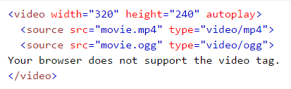
Video Tags 2
We will continue with the same tag. It is used with other embedded tags like <source> and <track>. The first is used for both audio and video, and it defines where the file is stored in the computer or compared to the html file. The second is for the text tracks and both audio and video.
Media formats supported by video tags are mp4, ogg and webm.
Using JavaScript, this tag can be displayed with controllers like: Play, Pause, Stop, Next or Previous.
Example of video tag…………………..

Slide 5
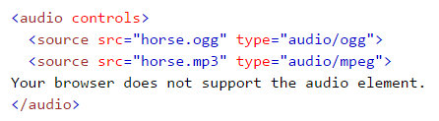
Audio Tags 1
Talking about Audio tags past, we will see that it’s the same than Videos tags. But the syntax is not the same.
As we all can see, it is used for audio purposes. We can play Audio through this tag.
The tag is written as this: <audio>. But, other parameter will be linked to it like the famous <source>.
The main formats are: MP3, Wav and Ogg.
Here is an example……………………

Slide 6
Canvas Tags 1
Canvas tags are another type of HTML5 tags. It is used for graphical purpose. For example, a gradient filled rectangle is a canvas.
It is used to draw and fill and, much more, to add images.
It is written in JavaScript’s syntaxes but, embedded in HTML.
The tag is: <canvas> and it has a lot of way to be written along with “context(ctx)” and others.
A simple example of this tag can be found here:

Slide 7
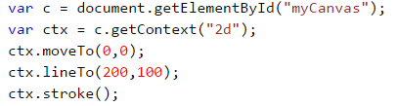
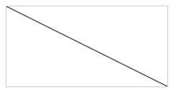
Canvas Tags 2
Another more complex example with it’s result.
=

Slide 8
Conclusion
We.ve made a study of these three tags and we are still at the surface of the orange. We will get into the core another time and we will figure out that they are just amazing words that turn into beautiful things.

